Slide 1
Lecture 25-27
Relational Database Design

Slide 2
Outline
The Process of Normalization
First Normal Form (1NF)
Second Normal Form (2NF)
Third Normal Form (3NF)

Slide 3
Lossless-join and Dependency Preservation Properties
Two important properties of decomposition.
Lossless-join property enables us to find any instance of the original relation from corresponding instances in the smaller relations.
Dependency preservation property enables us to enforce a constraint on the original relation by enforcing some constraint on each of the smaller relations.
© Pearson Education Limited 1995, 2005

Slide 4
Example of Lossless-Join Decomposition
Decomposition of R = (A, B, C) R₁ = (A, B) R₂ = (B, C)
A
B
C
A
B
B
C
α
β
1
2
A
B
α
β
1
2
1
2
A
B
r
∏_{A,B}(r)
∏_{B,C}(r)
∏_{A} (r) ∏_{B} (r)
A
B
C
α
β
1
2
A
B

Slide 5
Example of Dependency Preservation
R(A B C D)
FD₁: A ➔ B
FD₂: B ➔ C
FD₃: C ➔ D
Decomposition:
R₁(A B C)
R₂(C D)
R₁( A B C )
FD₁
FD₂
R₂( C D )
FD₃
Has all 3 functional dependencies!
Therefore, it’s preserving the dependencies

Slide 6
Example of Non-Dependency Preservation
R₁( A C D )
R(A B C D)
FD₁: A ➔ B
FD₂: B ➔ C
FD₃: C ➔ D
Decomposition:
R₁(A C D)
R₂(B C)
FD₃
R₂( B C )
FD₂
Does not support FD₁: A => B
Therefore, it does not preserve the dependencies

Slide 7
More Examples
R(A B C D E)
FD₁: A ➔ B
FD₂: BC ➔ D
Decomposition:
R₁(A C E)
R₂(B C D)
R₃(A B)
R(A, B, C, D, E, F )
FD₁: D ➔ A, B
FD₂: C ➔ E, F
Decomposition:
R₁( A, C, D ) R₂( A, D, B ) R₃( D, E, F ) R₄( C, E, F )
Notes:
not

Slide 8
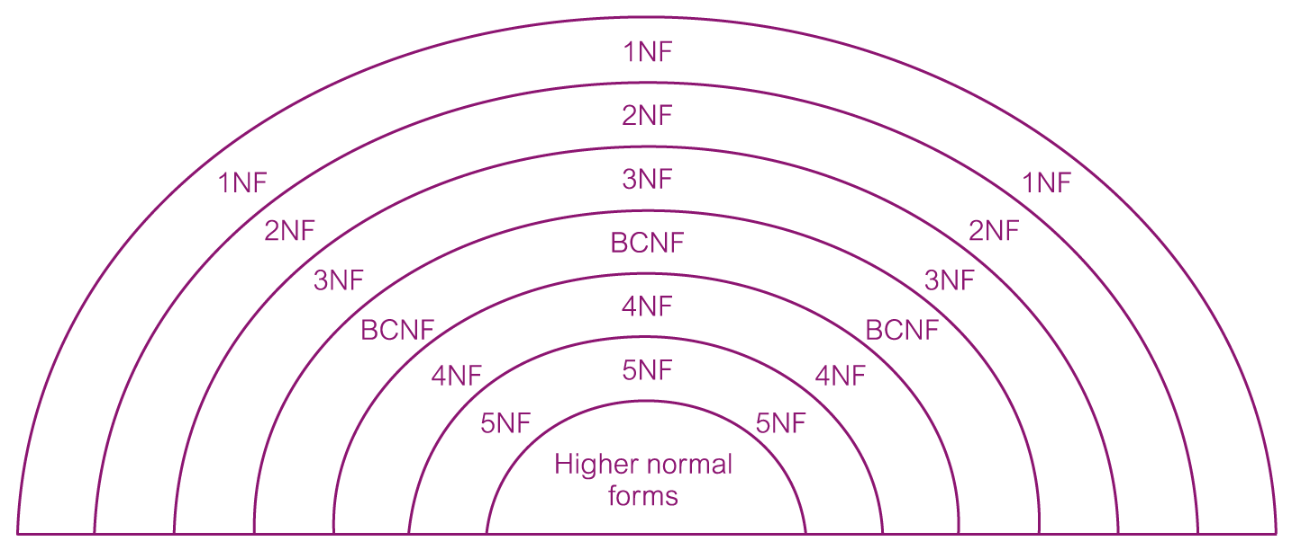
The Process of Normalization
As normalization proceeds, the relations become progressively more restricted (stronger) in format and also less vulnerable to update anomalies.
© Pearson Education Limited 1995, 2005

Slide 9
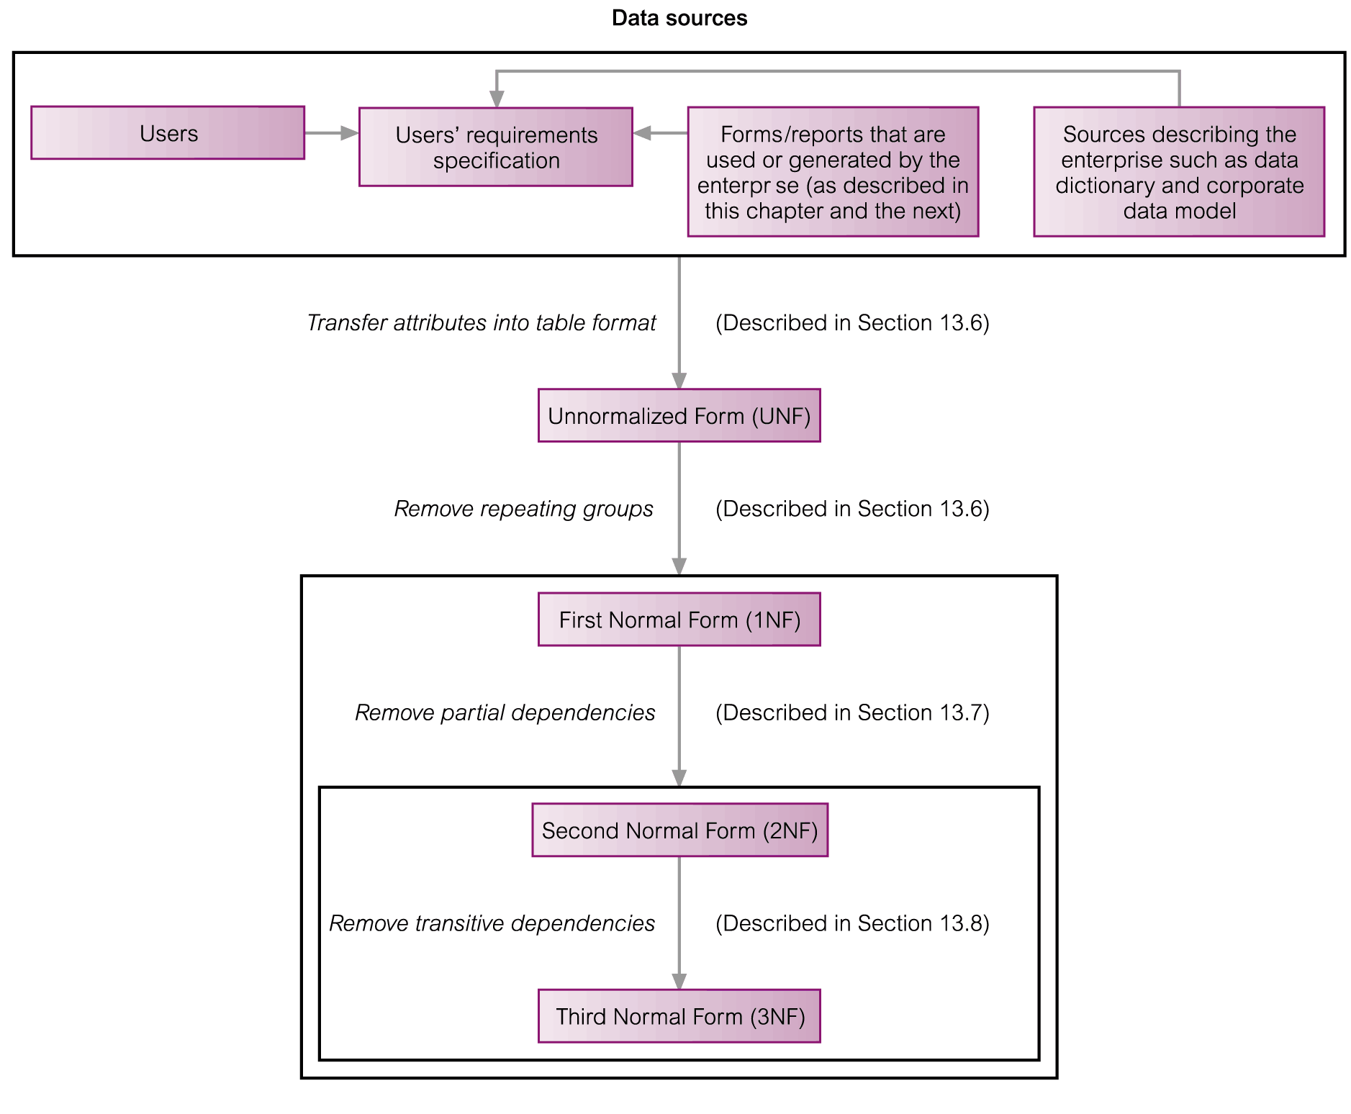
Normalization Process
© Pearson Education Limited 1995, 2005

Slide 10
Unnormalized Form (UNF)
A table that contains one or more repeating groups.
To create an unnormalized table
Transform the data from the information source (e.g. form) into table format with columns and rows.
© Pearson Education Limited 1995, 2005

Slide 11
First Normal Form (1NF)
A relation in which the intersection of each row and column contains one and only one value.
© Pearson Education Limited 1995, 2005

Slide 12
UNF to 1NF
Nominate an attribute or group of attributes to act as the key for the unnormalized table.
Identify the repeating group(s) in the unnormalized table which repeats for the key attribute(s).
Remove the repeating group by
Entering appropriate data into the empty columns of rows containing the repeating data (‘flattening’ the table).
Or by
Placing the repeating data along with a copy of the original key attribute(s) into a separate relation.
© Pearson Education Limited 1995, 2005

Slide 13
Example
Option 2
Roll No | Name | Course 1 | Course 2
1 | Sai | C | C++
2 | Hina | Java | NULL
3 | Atlas | C | DBMS
Roll No | Name | Courses
1 | Sai | C/C++
2 | Hina | Java
3 | Atlas | C/DBMS
Option 3
Roll No | Name
1 | Sai
2 | Hina
3 | Atlas
Roll No | Courses
1 | C
1 | C++
2 | Java
3 | C
3 | DBMS
Option 1
Roll No | Name | Courses
1 | Sai | C++
1 | Sai | C++
2 | Hina | Java
3 | Atlas | C
3 | Atlas | DBMS

Slide 14
Second Normal Form (2NF)
Based on the concept of full functional dependency.
Full functional dependency indicates that if
A and B are attributes of a relation,
B is fully dependent on A if B is functionally dependent on A but not on any proper subset of A.
A relation that is in 1NF and every non-primary-key attribute is fully functionally dependent on the primary key. (There should not be any partial dependency)
© Pearson Education Limited 1995, 2005

Slide 15
1NF to 2NF
Identify the primary key for the 1NF relation.
Identify the functional dependencies in the relation.
If partial dependencies exist on the primary key remove them by placing then in a new relation along with a copy of their determinant.
© Pearson Education Limited 1995, 2005

Slide 16
Example
R(ABCDEF)
F{c→ F, E→A, EC→D, A→B}
c.k{ EC}
Prime attributes: {E C}
Non prime attributes: {A B D F}
Check whether a part of candidate key determined non prime attribute (partial dependency)
Yes then remove

Slide 17
Third Normal Form (3NF)
Based on the concept of transitive dependency.
Transitive Dependency is a condition where
A, B and C are attributes of a relation such that if A → B and B → C,
then C is transitively dependent on A through B. (Provided that A is not functionally dependent on B or C).
A relation that is in 1NF and 2NF and in which no non-primary-key attribute is transitively dependent on the primary key.
© Pearson Education Limited 1995, 2005

Slide 18
2NF to 3NF
Identify the primary key in the 2NF relation.
Identify functional dependencies in the relation.
If transitive dependencies exist on the primary key remove them by placing them in a new relation along with a copy of their dominant.
© Pearson Education Limited 1995, 2005

Slide 19

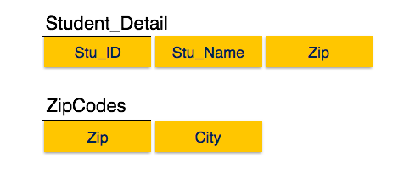
Example
We find that in the above Student_detail relation, Stu_ID is the key and only prime key attribute. We find that City can be identified by Stu_ID as well as Zip itself. Neither Zip is a superkey nor is City a prime attribute. Additionally, Stu_ID → Zip → City, so there exists transitive dependency.

Slide 20
General Definitions of 2NF and 3NF
Second normal form (2NF)
A relation that is in first normal form and every non-primary-key attribute is fully functionally dependent on any candidate key.
Third normal form (3NF)
A relation that is in first and second normal form and in which no non-primary-key attribute is transitively dependent on any candidate key.
© Pearson Education Limited 1995, 2005

Slide 21
Example - A Report

Slide 22
Example - UNF

Slide 23
Example - Normalization UNF to 1NF

Slide 24
Example - UNF to 1NF (Alternative)

Slide 25
FDs for Customer_Rental Relation
Primary key: Customer_No + Property_No
Full Functional Dependency:
(Customer_No+Property_No)->(RentStart, RentFinish)
Partial Dependency:
(Customer_No+Property_No)->Cname
(Customer_No+Property_No)->(Paddress, Rent, Owner_No, Oname)

Slide 26
Customer_Rental to 2NF Relations

Slide 27
Property_Owner to 3NF Relations
Transitive Dependency:
Property_No->Owner_No
Owner_No ->OName

Slide 28
Process of Decomposition

Slide 29
Summary

Slide 30
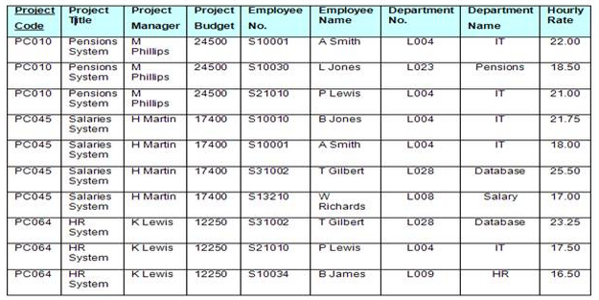
Example 2 - UNF

Slide 31
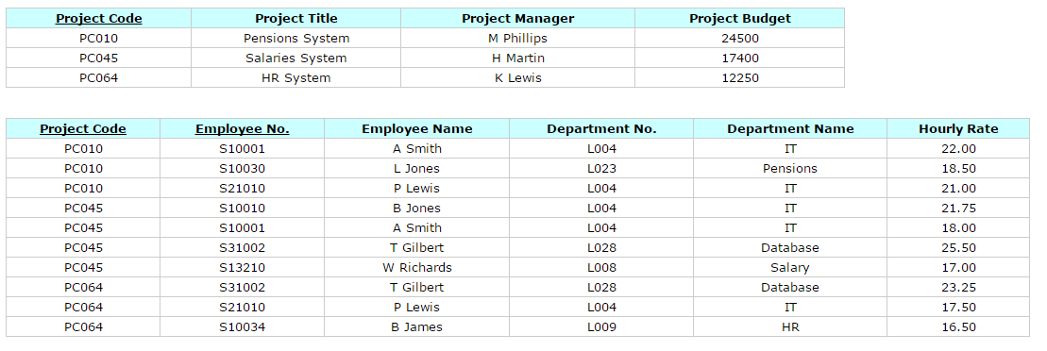
Table in 1NF

Slide 32
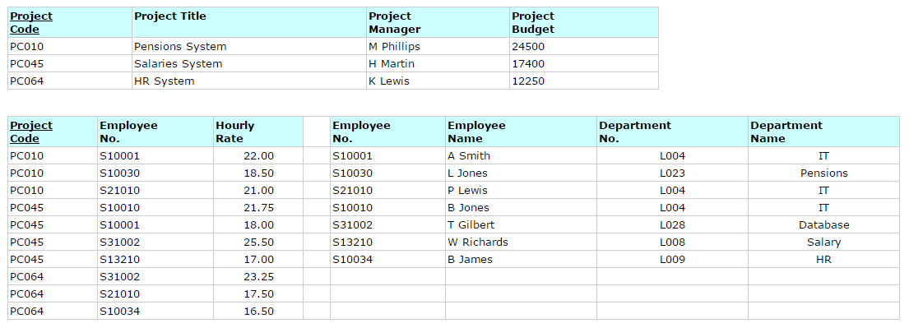
Tables in 2NF

Slide 33

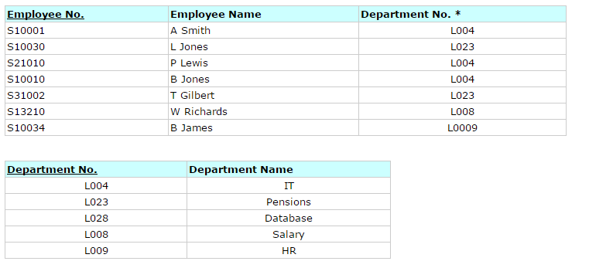
Tables in 3NF

Slide 34
Boyce-Codd Normal Form
A relation schema R is in BCNF with respect to a set F of functional dependencies if for all functional dependencies in F⁺ of the form
α→ β
where α ⊆ R and β ⊆ R, at least one of the following holds:
α → β is trivial (i.e., β ⊆ α)
α is a superkey for R
Example schema not in BCNF:
instr_dept (ID, name, salary, dept_name, building, budget )
because dept_name→ building, budget holds on instr_dept, but dept_name is not a superkey

Slide 35
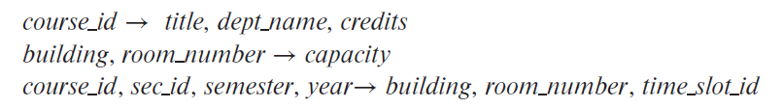
Boyce-Codd Normal Form
class (course_id, title, dept_name, credits, sec_id, semester, year, building, room number, capacity, time_slot_id)
Functional Dependency Set:
Key????

Slide 36
Normalization - Example
Cust.ID | Customer Name | Book Name | Shipping Address | Author | Author E-mail | Publisher | Publisher Contact | Price
1 | Ali | DBMS | Sukkur | a | a-yahoo.com | Pearson | 01-756 | 500
2 | Aamir | OS | Karachi | b | b-yahoo.com | Wiley | 01-111 | 300
3 | Sameer | DBMS | Islamaabad | a | a-yahoo.com | Pearson | 01-756 | 500
3 | Sameer | AI | Islamabad | b | b-yahoo.com | Wiley | 01-111 | 400
4 | Ali | OS | Karachi | b | b-yahoo.com | Wiley | 01-111 | 300

Slide 37
Normalization – 1NF
Cust.ID | Customer Name | Book Name | Shipping Address | Author | Author E-mail | Publisher | Publisher Contact | Price
1 | Ali | DBMS | Sukkur | a | a-yahoo.com | Pearson | 01-756 | 500
2 | Aamir | OS | Karachi | b | b-yahoo.com | Wiley | 01-111 | 300
3 | Sameer | DBMS | Islamaabad | a | a-yahoo.com | Pearson | 01-756 | 500
3 | Sameer | AI | Islamabad | b | b-yahoo.com | Wiley | 01-111 | 400
4 | Ali | OS | Karachi | b | b-yahoo.com | Wiley | 01-111 | 300
Key ???

Slide 38
Normalization – 2NF
Customer ID | Book Name
1 | DBMS
2 | OS
3 | DBMS
3 | AI
4 | OS
Book Name | Author | Author E-mail | Publisher | Publisher Contact | Price
DBMS | a | a-yahoo.com | Pearson | 01-756 | 500
OS | b | b-yahoo.com | Wiley | 01-111 | 300
DBMS | a | a-yahoo.com | Pearson | 01-756 | 500
AI | b | b-yahoo.com | Wiley | 01-111 | 400
OS | b | b-yahoo.com | Wiley | 01-111 | 300
Customer ID | Customer Name | Shipping Address
1 | Ali | Sukkur
2 | Aamir | Karachi
3 | Sameer | Islamaabad
3 | Sameer | Islamabad
4 | Ali | Karachi

Slide 39
Normalization – 2NF
Customer ID | Book Name
1 | DBMS
2 | OS
3 | DBMS
3 | AI
4 | OS
Book Name | Author | Author E-mail | Publisher | Publisher Contact | Price
DBMS | a | a-yahoo.com | Pearson | 01-756 | 500
OS | b | b-yahoo.com | Wiley | 01-111 | 300
AI | b | b-yahoo.com | Wiley | 01-111 | 400
Customer ID | Customer Name | Shipping Address
1 | Ali | Sukkur
2 | Aamir | Karachi
3 | Sameer | Islamaabad
4 | Ali | Karachi

Slide 40
Normalization – 3NF
Customer ID | Book Name
1 | DBMS
2 | OS
3 | DBMS
3 | AI
4 | OS
Customer ID | Customer Name | Shipping Address
1 | Ali | Sukkur
2 | Aamir | Karachi
3 | Sameer | Islamaabad
4 | Ali | Karachi
Book Name | Author | Publisher | Price
DBMS | a | Pearson | 500
OS | b | Wiley | 300
DBMS | a | Pearson | 500
AI | b | Wiley | 400
OS | b | Wiley | 300
Author | Author E-mail
a | a-yahoo.com
b | b-yahoo.com
a | a-yahoo.com
b | b-yahoo.com
b | b-yahoo.com
Publisher | Publisher Contact
Pearson | 01-756
Wiley | 01-111
Pearson | 01-756
Wiley | 01-111
Wiley | 01-111

Slide 41
Normalization – 3NF
Customer ID | Book Name
1 | DBMS
2 | OS
3 | DBMS
3 | AI
4 | OS
Customer ID | Customer Name | Shipping Address
1 | Ali | Sukkur
2 | Aamir | Karachi
3 | Sameer | Islamaabad
4 | Ali | Karachi
Book Name | Author | Publisher | Price
DBMS | a | Pearson | 500
OS | b | Wiley | 300
DBMS | a | Pearson | 500
AI | b | Wiley | 400
OS | b | Wiley | 300
Author | Author E-mail
a | a-yahoo.com
b | b-yahoo.com
Publisher | Publisher Contact
Pearson | 01-756
Wiley | 01-111

Slide 42
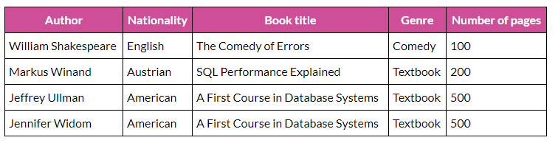
Home Work

Slide 43
Suggested Reading
Chapter 14 of Database Systems: A Practical Approach to Design, Implementation, and Management by Thomas Conolly 6th Edition
Chapter 8 of Database System Concepts by Abraham Silberschatz

Slide 44
References
https://www.db-book.com/db6/slide-dir/index.html
https://www.pearson.com/us/higher-education/product/Connolly-Powerpoint-Slides-for-Database-Systems

